Slide 1
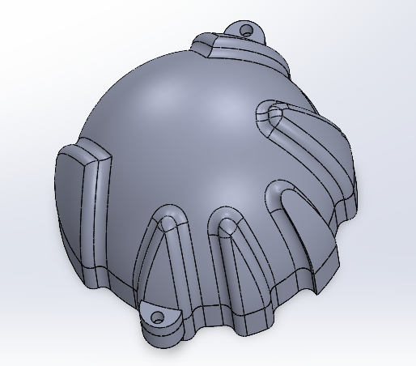
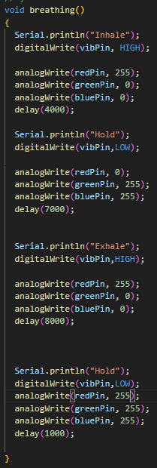
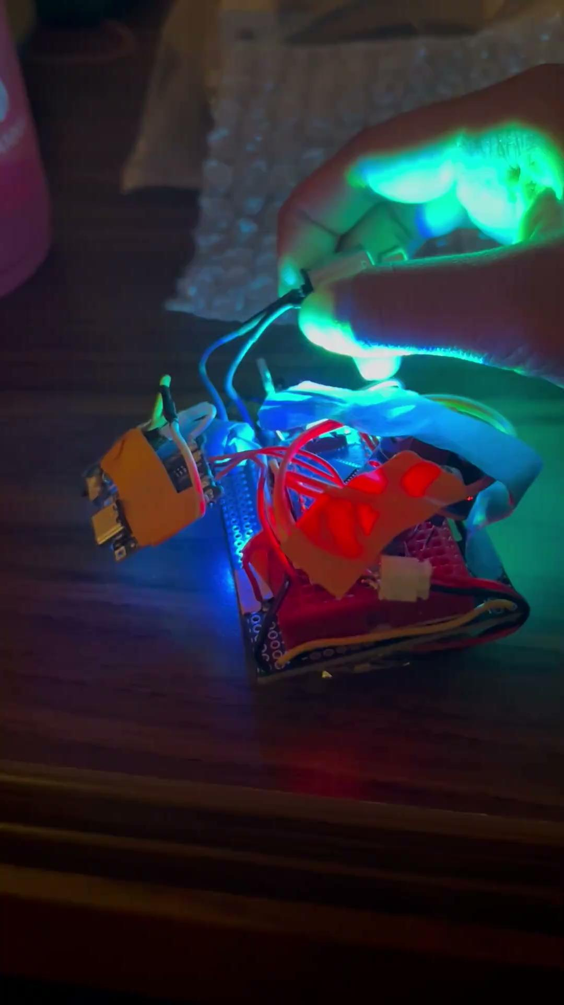
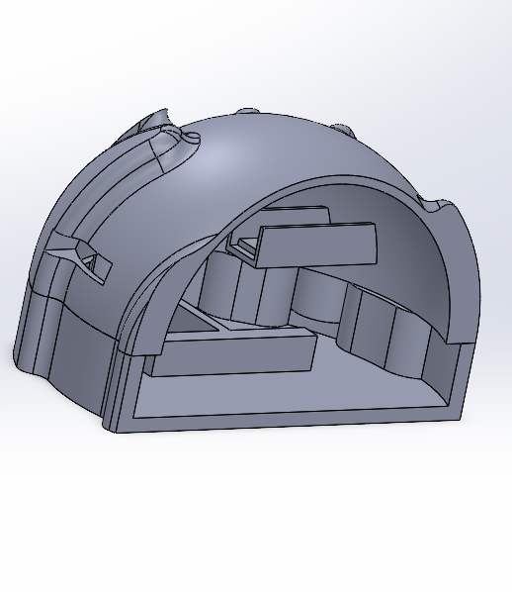
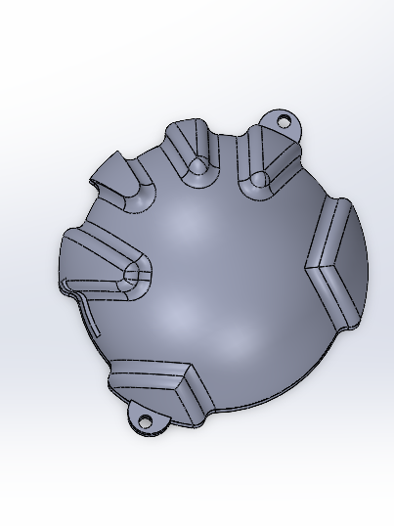
BuzzyBee: Handheld focusing + breathing device
Sachi Mehta, Cedric Yang, Saul Juarez
Notes:
Intro
-Name
-major
-team name
Purpose
-4-7-8 breathing buzz
-scientifically proven to help people with panic, anxiety, or nervousness
Code
4 seconds the device vibrates: red
7 seconds it is quiet as you hold your breath : Blue
8 seconds it buzzes again : Red
1 second break: Off
Then it loops
Electronics
We uploaded this code to an arduino nano
Which is powered by a rechargeable lipo battery
Nano controls a vibration motor and 2 rgb leds
Which I soldered onto a protoboard to save some space in our design
Casing/structure
-Hand shape to give the sensation of holding hand- primary function of calming down
-Structure, base plate, motor hold…battery casing…
Future improvements
The application of a RTC clock module from our original design
LEDS should fade in and out smoothly for improved aesthetics
Silicone casing for comfort

